Slide 1







Data Findings: Stack Overflow Survey of Software Professionals 2019
Mymuna
March 2, 2023

Slide 2



OUTLINE
Executive Summary
Introduction
Methodology
Results
Visualization – Charts
Dashboard
Discussion
Findings & Implications
Conclusion
Appendix

Slide 3

EXECUTIVE SUMMARY
This report summarizes key findings from an analysis of data collected as part of the 2019 Stack Overflow Developer Survey.
The analysis yielded insights regarding the following:
Most popular languages, databases, and other technologies.
Attitudes reflecting which technologies will become most popular in the future.
Demographics.
These findings are relevant to current and aspiring developers, recruiters, and educators.

Slide 4

INTRODUCTION
Analyze technology usage and trends in software and web development among developers around the world.
Purpose of this Analysis:
Identify the top programming languages, databases, and platforms in demand.
Identify skill requirements for future.
Qualifications for hiring.
Through this report, target consumers could quickly understand the trend of technology usage and identify what they should learn additionally to better find jobs related to this field.

Slide 5

METHODOLOGY
The data was collected through survey, API and web scraping.
Survey: currently used technology, technology desired in the future, and demographics.
API: job posting data
Web scraping: popular language and salary
Sources of Data:
Link to Stack Overflow’s dataset.
Salary survey results.

Slide 6
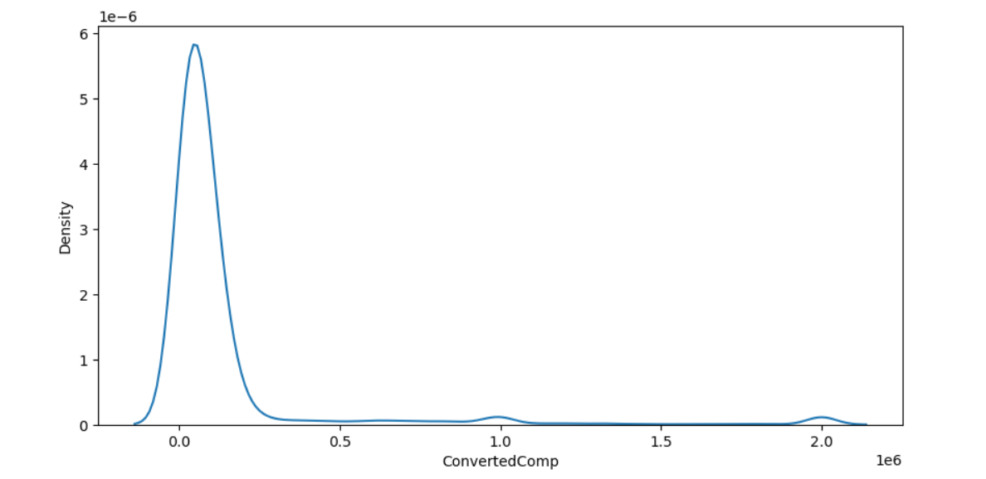
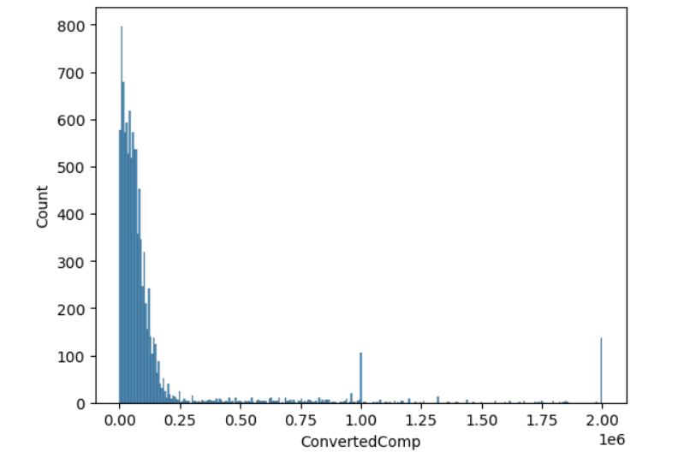
RESULTS
Distribution Curve and Histogram regarding total annual compensation were computed.
* ConvertedComp = Salary converted to annual USD salaries using the exchange rate on 2019-02-01, assuming 12 working months and 50 working weeks.

Slide 7
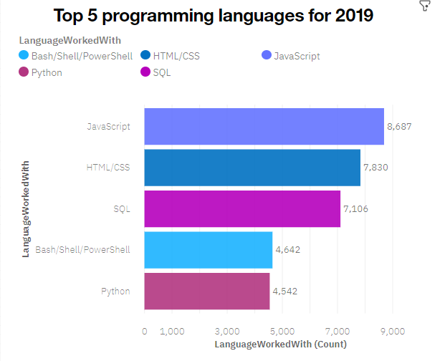
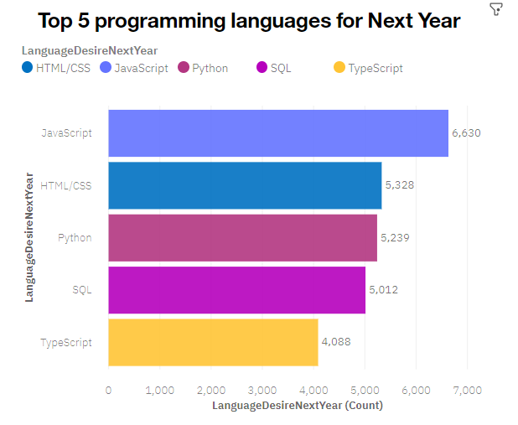
PROGRAMMING LANGUAGE TRENDS
Current Year
Next Year

Slide 8
PROGRAMMING LANGUAGE TRENDS - FINDINGS & IMPLICATIONS
Findings
Javascript and HTML/CSS were the most popular in 2019 and will likely remain so the following year
SQL was also popular in 2019 and will likely remain so.
Increasing interests in Python and TypeScript.
Decreasing interest in Bash/ PowerShell.
Implications
Javascript and HTML/CSS remain the dominant languages.
However, TypeScript may catch up in the future.
SQL remains the preferred language for big data storage and querying—it will likely remain so.
Python’s rising popularity likely reflects the growth of AI and ML work.

Slide 9
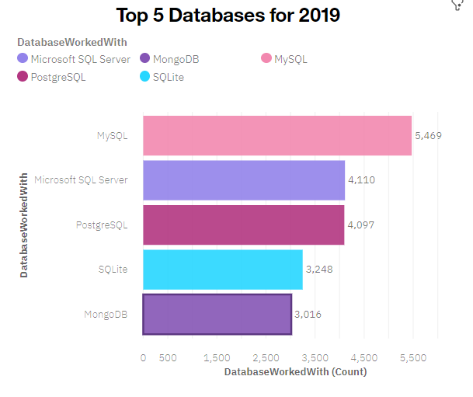
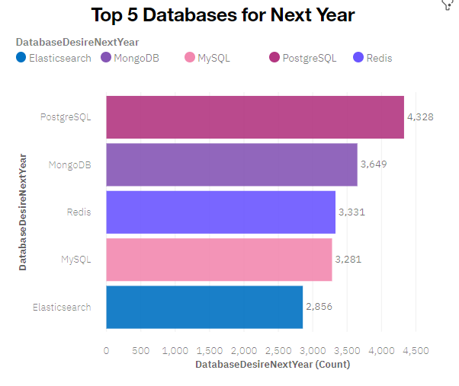
DATABASE TRENDS
Current Year
Next Year

Slide 10
DATABASE TRENDS - FINDINGS & IMPLICATIONS
Findings
SQL database programs were the most popular in 2019, with MySQL in the lead.
PostgreSQL was gaining popularity over other SQL database programs, and it was the most desired database for the next year.
MongoDB was popular in 2019 and gaining interest.
Implications
SQL database programs are gaining popularity, which reflects a growing need to handle nonrelational and unstructured data.
Current and aspiring data analysts should develop competence in SQL database programs
Getting familiar in MongoDB will also increase your competitiveness in the job market.

Slide 11

DASHBOARD
The following link contains the full, interactive Cognos dashboard summarizing (a) current technology use, (b) future technology trend, and (c) demographics of the survey respondents:
https://eu-de.dataplatform.cloud.ibm.com/dashboards/22b2d291-686f-41e0-a61a-ad03b193feb3/view/541bd0230fab0c9357fdeae4079c7e03743e250bb7bb830280d77b490e327697f33a4593c82a4a09d311046af5ed435b9f

Slide 12
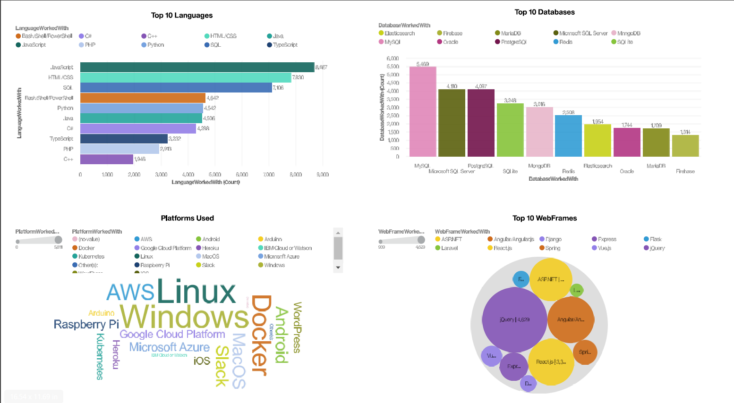
DASHBOARD TAB 1

Slide 13
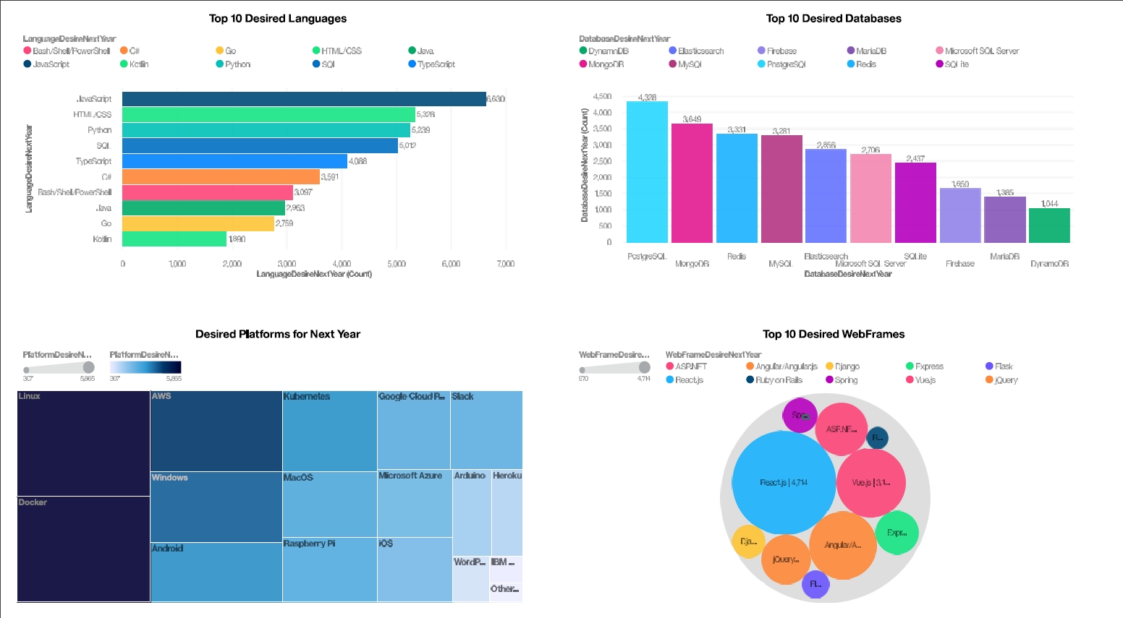
DASHBOARD TAB 2

Slide 14
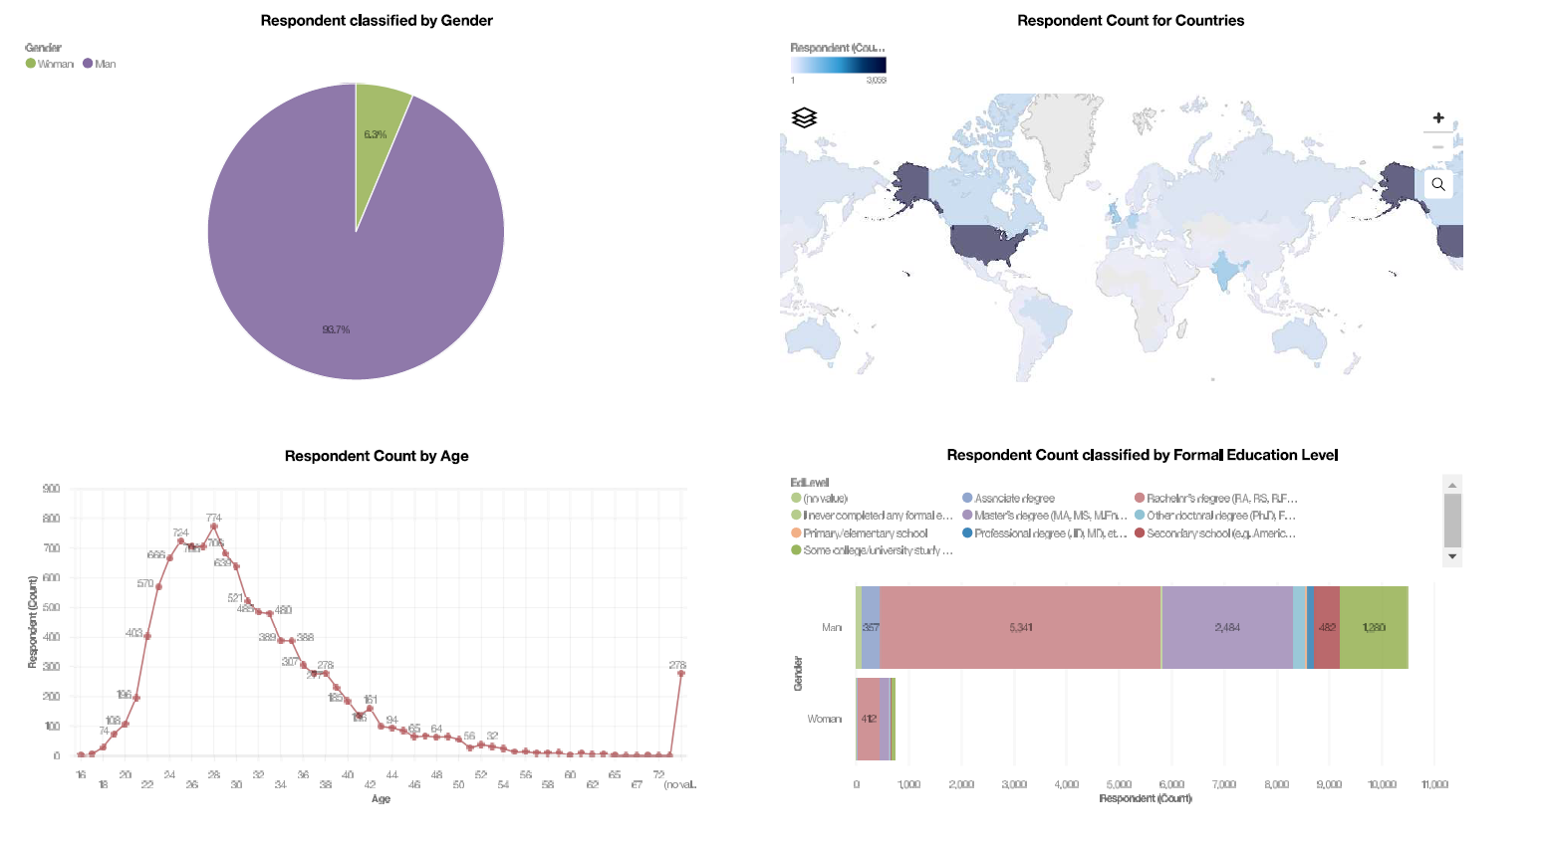
DASHBOARD TAB 3

Slide 15
DISCUSSION
The findings yield insights into the following questions:
What kinds of developer technologies are in top demand?
Which technologies should prospective developers and data professionals be learning?
Should they learn multiple languages to remain competitive in the job market, or would one language always reign supreme?
Which technologies should educators place more emphasis on teaching in upcoming years?
What is the developer demographic like?
Is there a gender representation gap?

Slide 16
OVERALL FINDINGS & IMPLICATIONS
Findings
High usage and interest in Javascript and HTML/CSS remain high.
There’s also increasing interest in Typescript.
Increasing interest in Python.
High usage and interest in SQL. MySQL had the highest usage in 2019, but PostgreSQL is gaining interest and was the most desired database program for the next year.
MongoDB was the most used in 2019 and desired for the next year.
A severe gender representation gap (in favor of men).
Implications
Current and prospective developers may consider picking up Typescript in addition to Javascript and HTML/CSS.
With the growing need to handle big data and perform AI and ML work, data professionals should continue to enhance SQL competence but also enhance competence with other database programs and Python.
Businesses need to adapt to changing technology preferences, especially in terms of talent acquisition and development.
Educators, and organizations should work to minimize the gender representation gap.

Slide 17

CONCLUSION
A subset of data collected as part of the 2019 Stack Overflow Developer Survey was examined.
The findings yielded numerous insights into the technologies most used and desired by developers in addition to the developer demographic.
These insights should be particularly relevant for:
current and prospective developers aiming to remain competitive,
businesses aiming to upskill their talent,
And, educators in the field.
Recommended Languages and Databases:
Programming languages: JavaScript, HTML/CSS, Python.
Databases: MySQL, PostgreSQL, MongoDB.

Slide 18
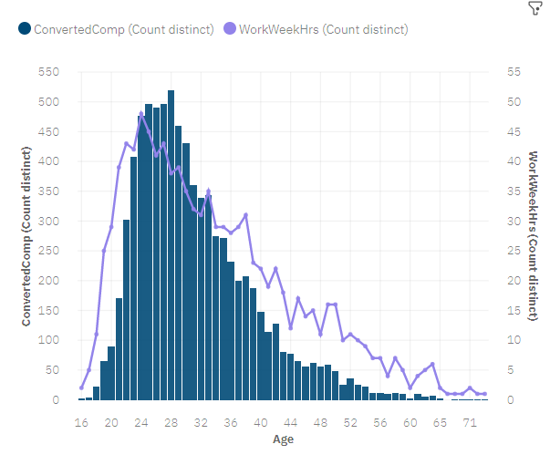

APPENDIX

Slide 19
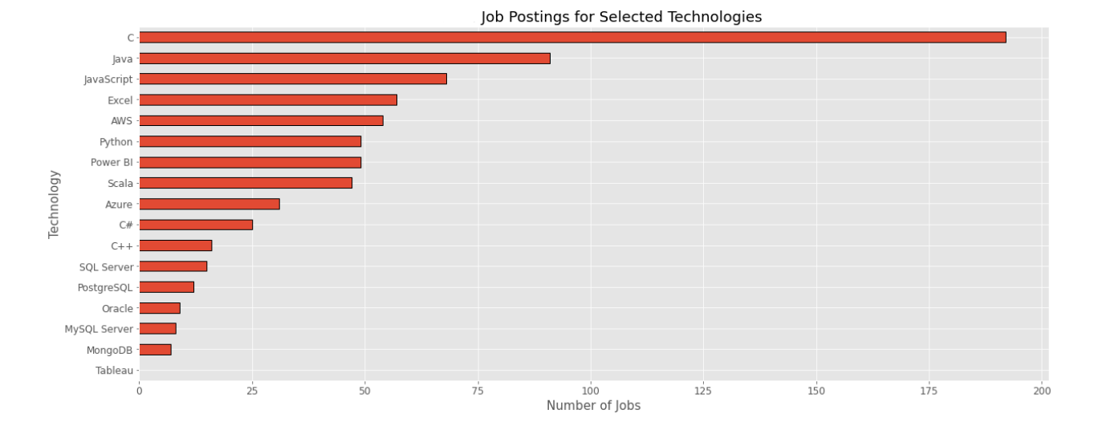
JOB POSTINGS

Slide 20
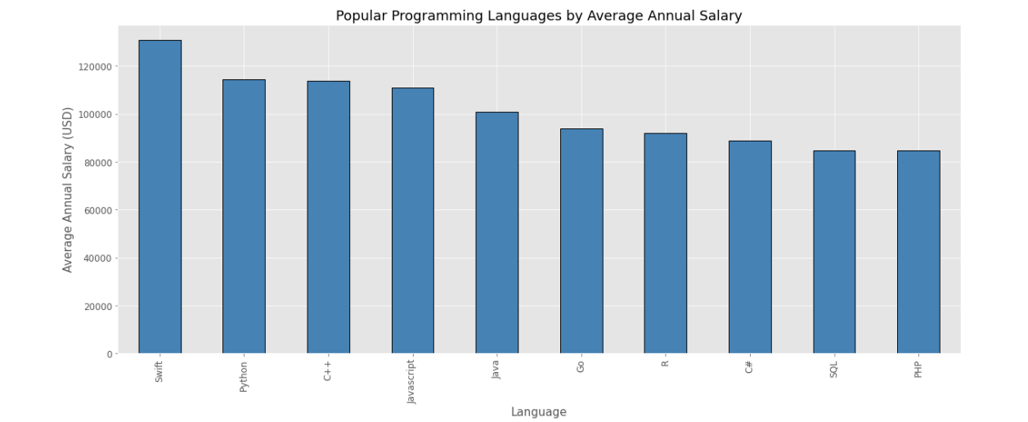
POPULAR LANGUAGES

